Slide 1
What is SPARTA?
SPARTA is a python GUI application which simplifies network infrastructure penetration testing by aiding the penetration tester in the scanning and enumeration phase. It allows the tester to save time by having point-and-click access to his toolkit and by displaying all tool output in a convenient way. If little time is spent setting up commands and tools, more time can be spent focusing on analysing results.

Slide 2
Sparta is information gathering tool and it is installed bydefault in kali linux. a Python script that integrates several recon and enumeration tools into a single, simple to use GUI. Sparta integrates the following tools- Nmap
Hydra
Nikto
CutyCapt
Mysql-default

Slide 3
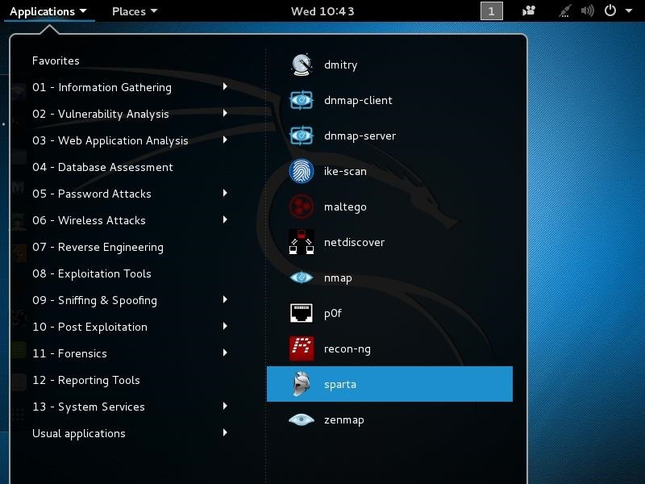
In first step Go to Applications -> Information Gathering -> sparta.

Slide 4
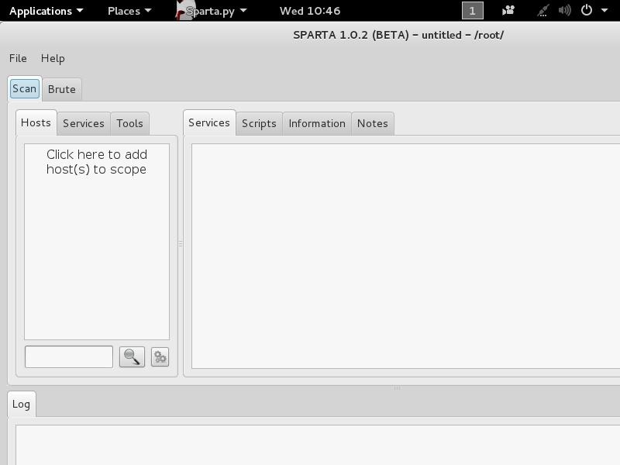
When you click on it, a GUI like that below will open.

Slide 5
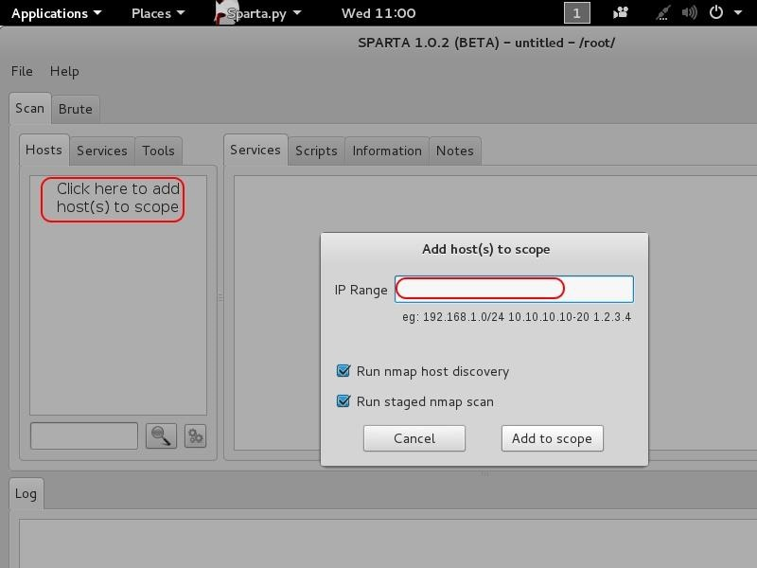
Add Hosts- To get started with Sparta, we need to provide it with hosts to scan and enumerate. If we click on the space that says "Click here to add host(s) to scope," it opens a window where we can add the IP addresses or the range of IP addresses to scan.

Slide 6
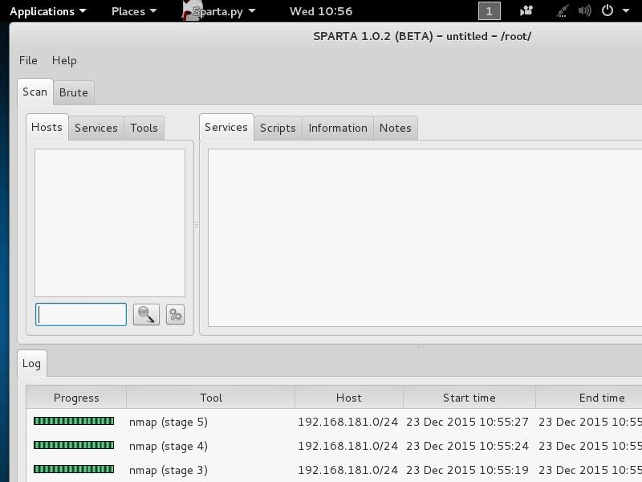
After adding our IP host range in the Window, click "Add to scope." Sparta will start scanning your hosts now.

Slide 7
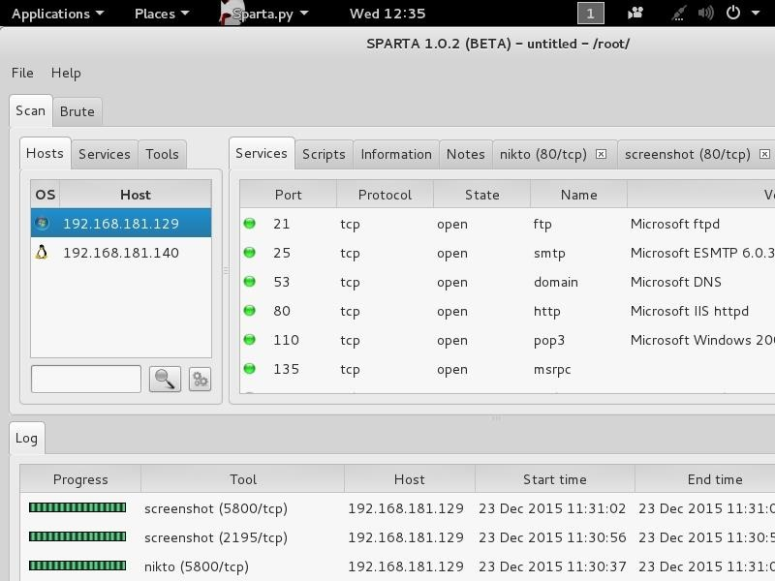
When Sparta is done scanning, it will provide you results like that below

Slide 8
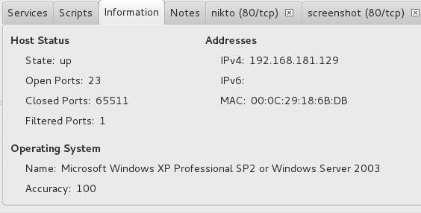
More Information If we go the "Information" tab, we can get more detailed information on the particular highlighted system.

Slide 9
Thank You

